Slide 1
Face Expression Recognition
University Roll No-2018686
Section – D
Group – G1
Class Roll No- 07
Course- B.TECH
Branch- CSE
Mentor - Mr. Saurabh Kumar Mishra

Slide 2

Introduction
Face emotion recognition is a technology that identifies and interprets human emotions by analyzing facial expressions through computer algorithms and deep learning techniques.
The goal of the project is to accurately classify facial expressions into seven emotion categories: angry, disgust, fear, happy, neutral, sad, and surprise.

Slide 3
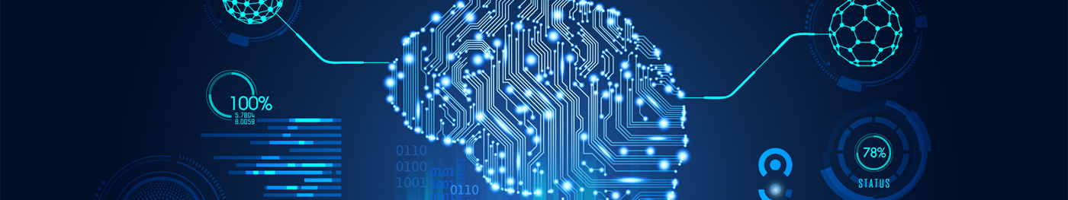
Prerequisites
HUMAN EMOTION
DEEP LEARNING
PYTHON
Human emotion refers to the different emotional states that individuals express through their facial expressions. These emotional states can include but are not limited to happiness, sadness, anger, fear, surprise, disgust, and neutrality.
Inspired from the structure and function of human brain. It is a subfield on ML and AI that focusses of training neural networks to perform complex tasks by learning from vast amount of data.
Python is a high-level, interpreted programming language known for its simplicity and readability. It allows developers to write code with fewer lines compared to other programming languages, making it easier to understand and maintain.

Slide 4
METHODOLOGY
LIBRARIES AND API
OPEN CV
NUMPY
PANDAS
KERAS
TENSORFLOW
Open-source computer vision and machine learning library.
Provides tools and functions for image and video processing ,object detection & emotion recognition
Use in code-
Accessing the webcam
Converting color spaces
Face detection
Drawing rectangles
Python library used for numerical computing
provides support for large arrays and matrices & provides functions to operate on these arrays
Use in code-
store pixel data of image in arrays
Normalization-pixel value b/w [0-1]
Reshaping the image data to match the i/p size required by CNN model
Used to manage and organize the image file path and corresponding labels.
Use in code-
During preprocessing phase used to create two data frames
1 for training and 1 for testing.
Each frame consists of two columns:
'Image' and 'label'
Open-Source high-level deep learning API written in python.
User friendly and easy to use.
Allows researchers and developers to build, experiment with, and deploy deep learning models quickly and efficiently.
that abstracts the complexities of TensorFlow and other backends.
TensorFlow is an open-source low level deep learning framework.
Developed by Google.
TensorFlow provides a flexible and low-level interface, allowing developers to have fine-grained control .
Allows users to build, train, and deploy machine learning models, with neural networks and deep learning architectures.

Slide 5
The process of face emotion recognition envolves the following steps-
1)Data collection- Collect labelled dataset of facial images that represent different emotions.
2)Preprocessing - Standardize their size
Convert them to grayscale
Normalize -Standard scale or range[0-1pix]
3)Model training - Train a deep learning model using labelled dataset(CNN)
4)Evaluate - To determine accuracy and performance using test dataset.
5)Real-Time Implementation- Implementation of model in live video-streams or webcam

Slide 6
Code Explanation
Import CV2 , Numpy and model_from_json (A function imported from keras module to load the pre-trained model.)
Pre-trained model "facialemotionmodel.json“ is loaded into the model_from_json function using read() function to create a neural network model.
Load the Haar Cascade Classifier with path “haarcascade_frontalface_default.xml”for face detection(pre trained classifier to detect faces in image).
Create a function ‘extract_features’ that does the following :
a) takes an image as input and converts it into a NumPy array.
b) reshape the image (1,48,48,1)
c) normalize the image by dividing by 255.0 to scale pixel values between 0 and 1.
Open the webcam using ‘VideoCapture’ function to capture video frames.
Create a dictionary ‘labels’ to map predicted Integer class labels to human readable expression.
Continuously capture frames from the webcam and convert them to greyscale using ‘cv2.cvtColor’ function
Haar Cascade is used to detect faces in the greyscale frame and detectMultiScale function returns the co-ordinates of the face.
The face region is extracted from the grayscale frame, and a blue rectangle is drawn around the detected face using cv2.rectangle.
The extracted face is resized to 48x48 pixels to match the input size of the model and converted to a feature array using extract_features function.
The model predicts the expression label for the face using model.predict.
The predicted label is mapped to the corresponding expression from the labels dictionary.
The predicted expression label is displayed above the detected face using cv2.putText.
The processed frame with detected faces and the predicted expression labels is displayed using cv2.imshow.
The cv2.waitKey(27) function waits for a key event for 27 milliseconds, and then the loop continues with the next frame.
except block handles any cv2.error that might occur during video capture, ensuring that the code continues to run without interruptions.

Slide 7
Result , Discussion and Application
For the face emotion recognition project, we have implemented a Convolutional Neural Network (CNN) model using Keras and OpenCV libraries to detect and recognize facial expressions in real-time from webcam or video input. The goal of the project is to accurately classify facial expressions into seven emotion categories: angry, disgust, fear, happy, neutral, sad, and surprise.
Model: Convolutional Neural Network (CNN)
Training Dataset Size: 28,821 images (across seven emotion categories)
Testing Dataset Size: 7,066 images (across seven emotion categories)
Image Size: 48x48 pixels (grayscale)
Epochs: 100
Training Accuracy: [97]
Testing Accuracy: [88]

Slide 8
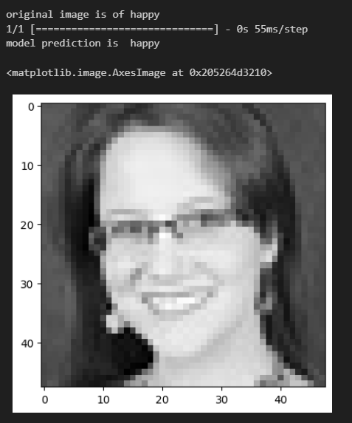
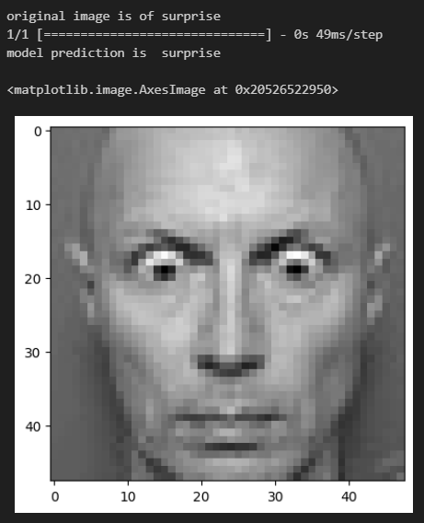
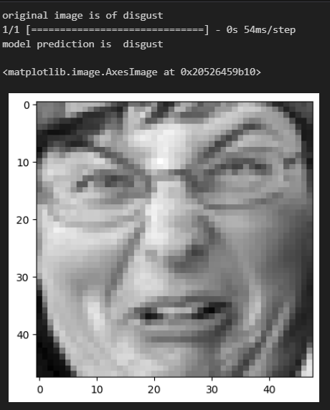
Prediction during Training

Slide 9
Prediction during Testing
Surprised
Neutral
Happy

Slide 10
Applications
1)Healthcare-Monitoring emotional disorders like Depression
2)Human Computer Interaction
3)Advertisment- Analyze consumers emotional response to advertisements
4)Audience Analysis-In events, conferences, or performances, to analyze the emotional responses of the audience.
5)Security and Surveillance
6)Education and Training:To access students emotional engagement and interests.
Future Works
Multi-Modal Emotion Recognition: Integrating facial expression analysis with other modalities like voice and body language for more robust emotion recognition.
Deep Reinforcement Learning: Exploring deep reinforcement learning to develop emotion-aware systems that can adapt behavior based on user emotions.
Large-scale Datasets: Creating larger and more diverse emotion datasets to improve model generalization.

Slide 11
Thank You

